Slide 1
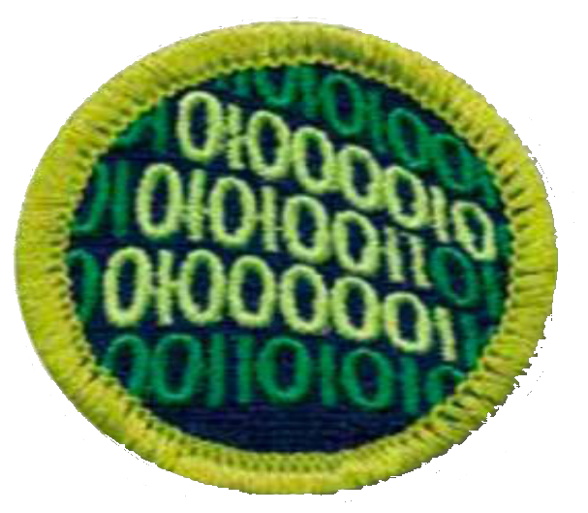
Programming
Merit Badge PowerPoint
© 2018 - 2020 Robert Baker
2020 modified by Keith Flesher
https://github.com/krflesher/T149

Slide 2


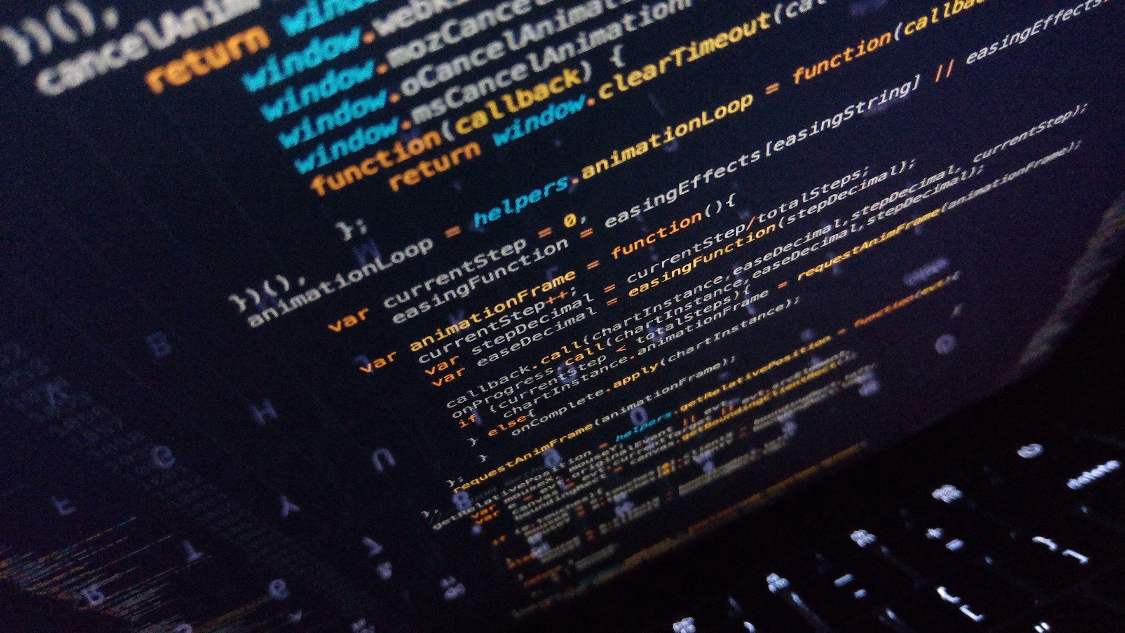
What is Programming

Slide 3
What is programming?
Programming is the act of inserting instructions into a computer or machine to be followed.
There are many different career fields involving the programming of computers; each utilizing different languages, techniques, and systems.
We are only going to cover a few of the different aspects of programming during this Merit Badge, but there are so many more.

Slide 4
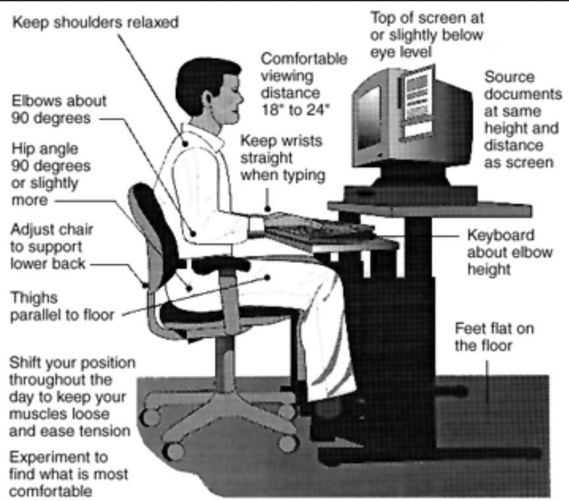
Safety
Normally programming normally involves computers, which use electricity. It is important to make sure all power-cords are not frayed, and too keep liquids far away to prevent electric shock.
RSI – Repetitive Stress Injury
Caused by typing for long periods of time and can cause pain in the wrists and hands
How can RSI be prevented?
Notes:
RSI Prevention
Proper keyboard height & position
Ergonomic keyboards
Quality chairs

Slide 5

Safety
Eye Strain can be caused by using computer screens for extended periods of time.
How can eye strain be prevented?
Notes:
Eye Strain Prevention
Proper monitor height
Blue blocking glasses
20/20/20 Rule

Slide 6
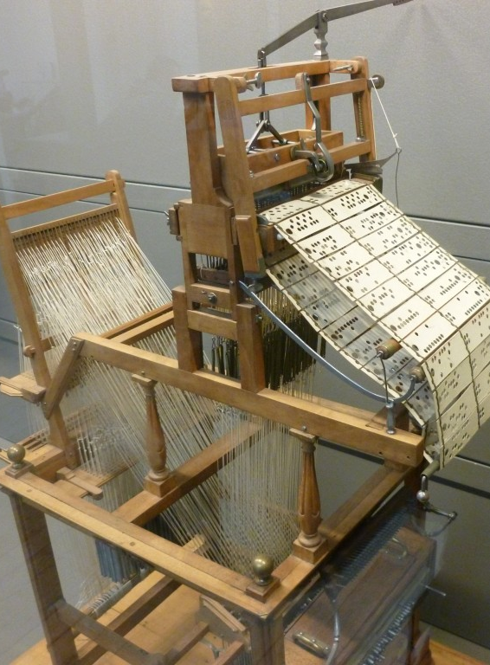
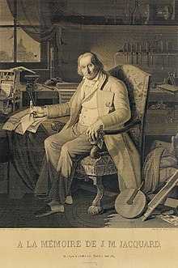
Before Computers
Before the modern electrical computer, mechanical devices used in factories were the first machines to be programmed.
An example is the Joseph Jacquard Loom (1804) which used hole-punched cards to “program” patterns into fabric.
The picture on the left is the loom.
The picture on the right is a portrait of Jacquard was woven in silk on a Jacquard loom and required 24,000 punched cards to create (1839). One of these portraits in the possession of Charles Babbage inspired him in using perforated cards in his Difference Engine.

Slide 7
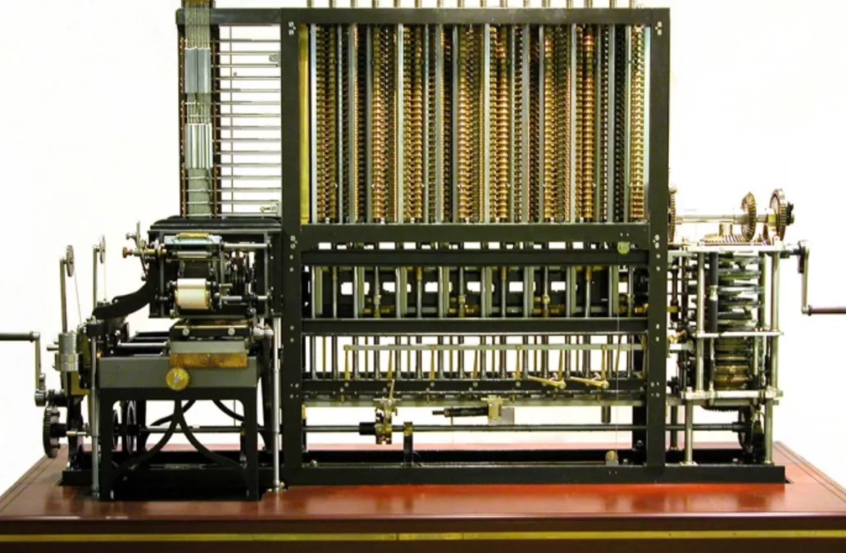
Before Computers
Charles Babbage in 1823 started work on his Difference Engine. It was programmed using punch cards and could do simple calculations to 31 digits. Do to high costs, it was not built until 1991, well after his death. It weighed 15 tons and was 8 ft tall.
It used human-power to turn the gears and cranks and output the result using wheels with digits painted on.
Fun Fact: The gear technology didn’t exist to build his machine, so Babbage invented new ways of cutting gears. This incidentally advanced machinery and factories during the end industrial revolution (1760-1840).
Ada Lovelace, the first programmer, theorized how to program Babbage's Machines.

Slide 8
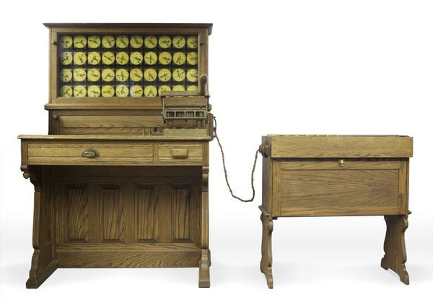
Before Computers
In 1885, Herman Hollerith designed the “Electric Tabulating System”, a machine designed to take on the 1890’s Census. It was an early Scantron-like machine using punch cards.
The 1880’s Census took 7 years to count, so due to the growing population, the 1890’s and 1900’s Censuses would have taken more than 10 years. This would not be good.
With his machine, the 1890’s Census only took 6 weeks rather than 10 years. This proved computers were a viable solution to many previously impossible problems.

Slide 9
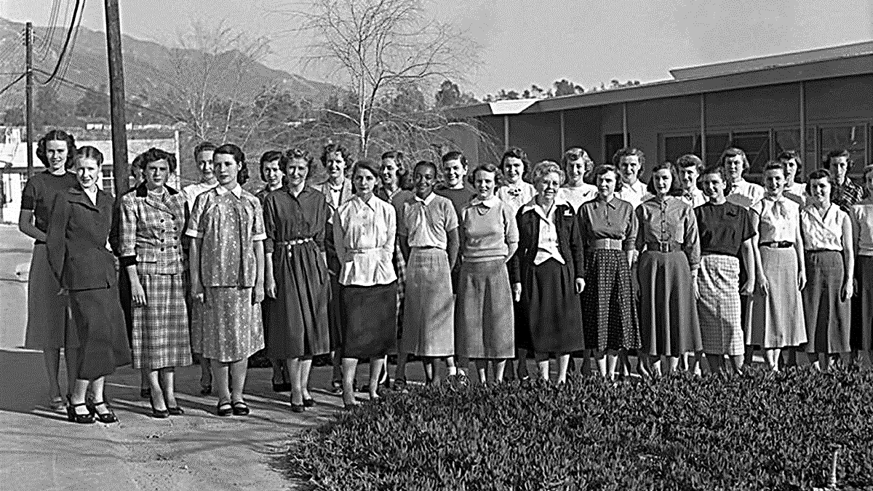
First Computers
What did the first computers look like?

Slide 10
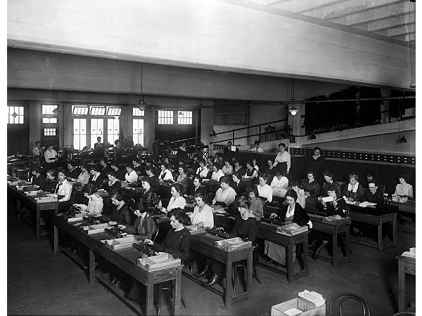
First Computers
A “Computer” used to be a job description, not an electronic machine
Women almost exclusively filled these positions.
Large agencies would have “Computer Rooms” with many ladies doing calculations by hand
A “kilogirl” was a unit of measurement equaling 1000 hours of computing labor

Slide 11
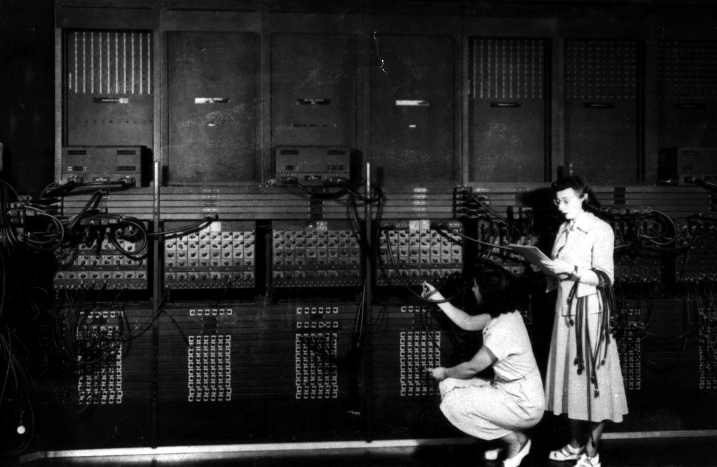
Early Computers
ENIAC – Electronic Numerical Integrator And Computer (1946)
First general-purpose computer
Used Base-10 instead of Binary (Base-2)
They used Vacuum Tubes and Mechanical Switches
Used to calculate firing-tables for the military.
UNIVAC – UNIVersal Automatic Computer (1951)
First commercial computer
Brought computers into the public eye after it correctly predicted the “total-upset, landslide”, 1952 Presidential Election.
ENIAC 1946 – What do you notice about this photo?
Notes:
Women, not men, were the ones running these early computers.
This led to many women leading computer science into the 21st century, i.e. Grace Hopper, who programed the ENIAC. She also designed COBOL. This language is still used today.

Slide 12
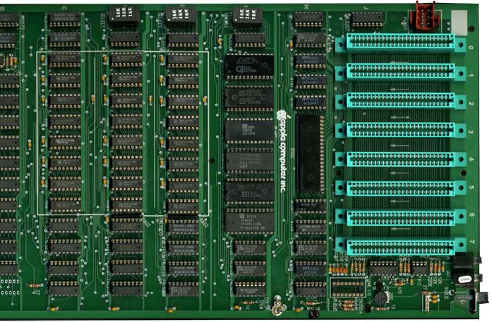
Pre-Modern Computers
After Vacuum Tube and Mechanical Switched computers, Integrated Circuits (ICs) allowed computers to get much smaller. Computers went from the Size of buildings to the size of desks.
This also allowed more powerful computers to be built because less space was needed.
This is an Apple2 motherboard from the late 1970s.
All the black chips make the CPU.
Each one is about 1” wide.

Slide 13
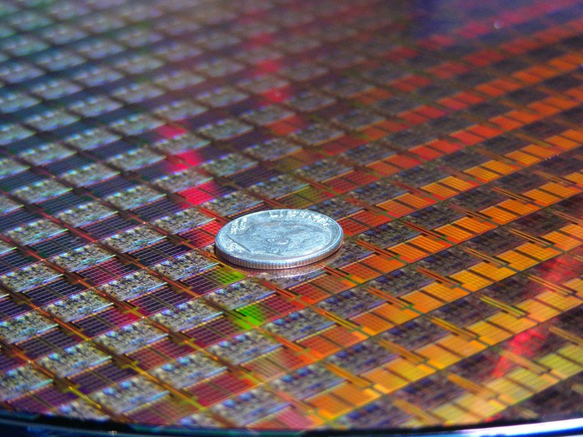
Modern Computers
The Microprocessor allowed computers to go from the size of desks to the size of a dime!
Each small square in this picture is a computer!
This allowed use to make computers even more powerful and allow us to use even more powerful language features.
Each “switch” in these chips are 10nm wide

Slide 14
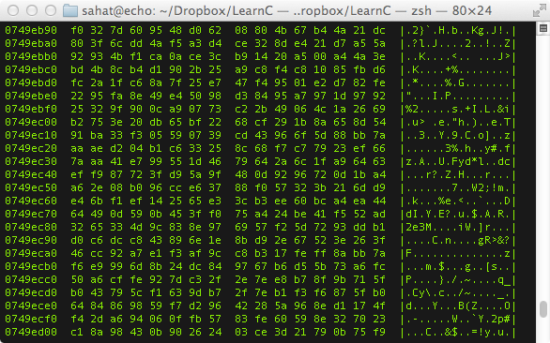
History of Programming
What was the first programming language?
Binary / Machine Language (ML)
Binary / ML is really hard to read, but it can be done.
Early computers used switches and cables to accomplish this.
It is insanely fast, only limited by hardware speed.
All programming languages end up as Binary / ML at some point during execution.
Notes:
Notice that is Binary / ML is actually represented in Hex, which is just a more compact way for writing Binary.
The column of 8 numbers on the left is the hardware memory address in RAM where each line of code is stored.
The next two big columns are the actual code separated into bytes (each 2 characters is 1 byte).
The third column is the ASCII representation of the data in the previous two big columns.

Slide 15
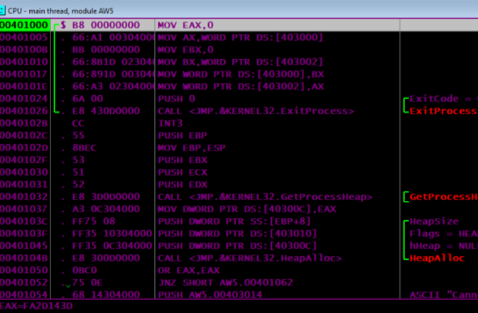
History of Programming
Next came Assembly Language (ASM)
Slightly easier to read than Binary / ML
Still very fast because it maps back to Binary / ML
Very few people ‘need’ to program is ASM
There is a different Assembly Language for each CPU design, so it is not portable code.
Why is portable code good?
Notes:
This is a program I wrote for my Assembly class.
In this photo you can see the hardware memory address in the left-most column.
In the widest column is a x86-Assembly code (MOV EAX,0)
The second column from the left is the Machine Language generated from the x86-Assembly code.

Slide 16
History of Programming
Next-Generation Languages came around the 1950’s.
They allowed:
Code portability between different systems
Easier to write, read and debug code
Allowed for new concepts (i.e. functions, classes, objects, OOP)
Explored new fields (i.e. science, math, computer science, data science, business)
The first big languages were… (in order of creation)
FORTRAN, LISP, COBOL, BASIC and Pascal
Notes:
A lot of old code that was written in FORTRAN or COBOL is still in use today because it would be too expensive to rewrite it.
Also there are huge sections of code that is “dead-code”. People don’t know what it does, so they don’t touch it and it just sits there.

Slide 17
Programming Now
How many languages do you recognize?
C
C++
Java
JavaScript
HTML
CSS
Python
Ruby
PHP
OpenCL
SQL
MATLAB
Erlang
Ada
Objective-C
Swift
Mathematica
C#
Visual Basic
Rust
F#
R
Go
PowerShell
BASH
TypeScript
PostScript
CoffeeScript
Perl
x86-Assembly MASM
RegEx
PL/SQL
MIPS
ColdFusion
LaTeX
XML
JSON
Ladder Logic
YAML
Batch

Slide 18
Programming Now
Why are the languages grouped into colors?
C
C++
Java
JavaScript
HTML
CSS
Python
Ruby
PHP
OpenCL
SQL
MATLAB
Erlang
Ada
Objective-C
Swift
Mathematica
C#
Visual Basic
Rust
F#
R
Go
PowerShell
BASH
TypeScript
PostScript
CoffeeScript
Perl
x86-Assembly MASM
RegEx
PL/SQL
MIPS
ColdFusion
LaTeX
XML
JSON
Ladder Logic
YAML
Batch

Slide 19
C
C++
Java
JavaScript
HTML
CSS
Python
Ruby
PHP
OpenCL
SQL
MATLAB
Erlang
Ada
Objective-C
Swift
Mathematica
C#
Visual Basic
Rust
F#
R
Go
PowerShell
BASH
TypeScript
PostScript
CoffeeScript
Perl
x86-Assembly MASM
RegEx
PL/SQL
MIPS
ColdFusion
LaTeX
XML
JSON
Ladder Logic
YAML
Batch

Slide 20
The Green Languages are General Programing Languages
The Purple Languages are Scripting Languages
The Red Languages are Markup Languages
The Blue Languages are Declarative Languages
The Orange Languages are Assembly Languages
It is important to match the type of work to the correct language to insure the best results.
Different types of languages have different purposes.
C
C++
Java
JavaScript
HTML
CSS
Python
Ruby
PHP
OpenCL
SQL
MATLAB
Erlang
Ada
Objective-C
Swift
Mathematica
C#
Visual Basic
Rust
F#
R
Go
PowerShell
BASH
TypeScript
PostScript
CoffeeScript
Perl
x86-Assembly MASM
RegEx
PL/SQL
MIPS
ColdFusion
LaTeX
XML
JSON
Ladder Logic
YAML
Batch

Slide 21
Programming Languages
Here are a few languages and the problems they try to tackle…
C++ – General Purpose, High Performance | ex. Game Engines, Desktop Apps (Adobe Photoshop, Chrome)
C – General Purpose, High Performance, Light Weight | ex. Linux OS, macOS, Integrated Circuits, Drivers
Java – General Purpose, Multiplatform | ex. Minecraft, Server Apps, Android Apps
C# – General Purpose, Windows Platform | ex. Unity Games, Server Apps, StackOverflow
Swift – General Purpose, iOS & macOS | ex. most apps for iPhones and macOS (replaced Objective-C)
SQL – Database Communication
JavaScript – General Web Scripting | ex. Interactive webpages, webpages that can run dynamic code
HTML – Webpage Design, Layout and Markup
CSS – Webpage Styling, Coloring, Fonts and Positioning
PHP – Web Server Code | ex. Backend Web Dev., Web Content Management Systems (i.e. WordPress)
TypeScript – Stricter Superset of JS that transpiles into JS |ex. Large JavaScript Apps
XML – Human and Machine readable file format for data sharing between apps

Slide 22
Programming Examples: Hello World
C++
#include <iostream> int main(int argc, char *argv[])
{
char myString[] = “Hello World!”;
std::cout << myString << std::endl;
return 0;
}
Java
class HelloWorld {
private String myString = "Hello World!";
public static void main(String args[]) {
System.out.println(myString);
}
}
Notice how different languages can look very different even when they are doing the same task.
Notice also how the bracing ( i.e. “{}”) style is different between languages.
Notes:
The reason for the different colors here is due to syntax highlighting.
Syntax Highlighting is a feature in programming apps where it automatically colors different parts of the code to increase readability.

Slide 23
Programming Examples: Hello World
C#
using System;
using System.Collections.Generic;
using System.Text;
namespace ConsoleApplication1
{
class HelloWorld
{
String myString = "Hello, world!";
static void Main(string[] args)
{
Console.WriteLine(myString);
}
}
}
X86 Assembly
.486
.model flat, stdcall
.stack 100h
option casemap :none
ExitProcess PROTO Near32 stdcall, dwExitCode:dword
putch PROTO Near32 stdcall, bChar:byte; .data
strMyString byte "Hello World",0
.code
main PROC
mov ecx, LENGTHOF strMyString
mov esi, OFFSET strMyString
L1:
invoke putch, byte PTR esi
inc esi
loop L1
invoke ExitProcess,0
main ENDP
END main
Notes:
The reason for the different colors here is due to syntax highlighting.
Syntax Highlighting is a feature in programming apps where it automatically colors different parts of the code to increase readability.

Slide 24
Programming Examples: Hello World
JavaScript
myString = "Hello World!";
console.log(myString);
Python
myString = 'Hello World!'
print(myString)
Notice how different languages can look very different even when they are doing the same task.
Notes:
The reason for the different colors here is due to syntax highlighting.
Syntax Highlighting is a feature in programming apps where it automatically colors different parts of the code to increase readability.

Slide 25
Programming Language Types
Languages can be split into a three different levels..
High-Level (ex. Python, Ruby, JavaScript, Java, SQL)
C-Level (ex. C, C++, Rust)
Low-Level (x86 Assembly, Machine Language)

Slide 26
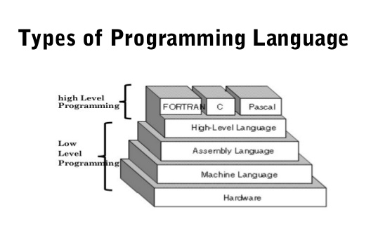
Programming Language Types
Why would you use a High-Level, Low-Level or C-Level language?
Low Level
Pros: Fast Execution, No Overhead, Single Platform, Compiled
Cons: Hard to read, write, debug, and maintain
Examples: ML, MASM, TASM, NASM, MIPS
High-Level
Pros: Easier to read, write, debug, and maintain, Multi-Platform, Compiled or Interpreted
Cons: Slower than Low-Level, not as much control over hardware
Examples: Python, Ladder-Logic, JavaScript, Java, SQL
C-Level
Best of both worlds, Compiled
Good control over hardware with ease of writing.
Examples: C, C++, Rust, FORTRAN, PASCAL
Note: Java, Python, etc.
are one level higher than
FORTAN, C and PASCAL

Slide 27
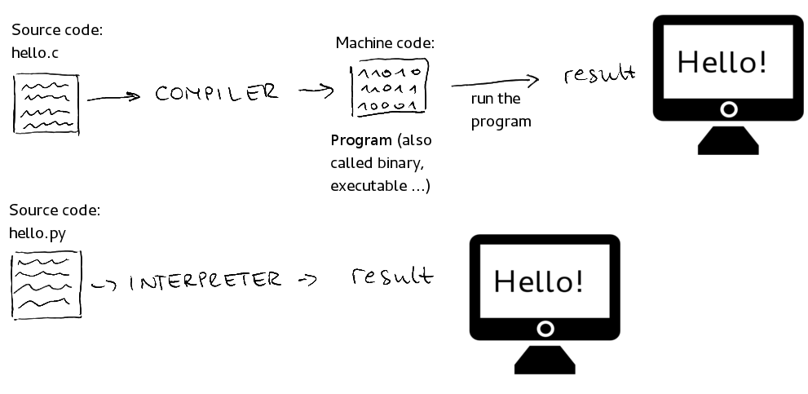
Programming Language Types
This graphic shows the difference between compiled and interpreted languages…
Use your computers to make a list of 3 compiled languages and 3 interpreted languages.
Where would you use a compiled languages vs an interpreted language?
Done every time
Done once
Done every time

Slide 28
Programmed Devices
Our lives are filled with so many programmed devices, you many not even notice…
What are somethings around your house that are programmed?
Smart TVs, Smart Door Bells
Xbox, PlayStation, Wii, Ms. Pacman
Microwave, Wi-Fi Router (these two are the same thing)
Etc..
What language do you think these were programmed in?

Slide 29
Languages & their uses
C
Computer applications
Embedded software
Compilers
Unix kernel
C++
Software
Video games
Adobe systems
Most MS apps
Browsers
Java
Minecraft
social media
Financial services
E-commerce
Insurance applications
JavaScript
Video game development
Interactive web functions
HTML
Backbone of internet
Website presentation
CSS
Web styling
Python
Scientific and numeric computing
Web and Internet Development
Teaching programming
Software Development
Desktop GUIs
Perl
Web automation
Database
Email handling
Text generation
System Administration

Slide 30
intellectual property (IP)
What are the four types of IP?
Copyright
Patent
Trademark
Trade Secret
Open your computers and go online.
Find the definitions of all four of these types of IP.
Notes:
Patents: Patents protect new, useful, and non-obvious inventions (ideas!). An invention can be a device, a structure, process, machinery, etc. (20 years most common)
Trademarks: Trademarks protect source identifications, usually for brands, slogans, logos, or designs (sometimes even scents or colors). A trademark protection may extend perpetually.
Copyrights: Copyrights protect original textual works and visual or artistic expressions. (Life of author + 70 yrs / OR 95 yrs from pub or 120 yrs from creation whichever is shorter)
Trade Secrets: Trade secrets protect valuable secret information like ideas that must be kept confidential. Others to whom they are disclosed to must also keep them confidential. Similar to trademarks, trade secret protection may extend perpetually.
(From https://kgulick.com/differencepatentandtrademark/)

Slide 31
intellectual property (IP)
What is …
Copyright – protects a particular expression of an idea that the author created (i.e. PowerPoints, Game Art, Specific Code)
Patent – protects useful innovative processes or methods, machines, manufactured items, or “compositions of matter” (i.e. a new and revolutionary math algorithm used in an app)
Trademark – protects a word, phrase, symbol or sound that identifies and distinguishes the source of a particular product or service (i.e. Windows Logo, “Your mattress is freeee”, etc.)
Trade Secret – protects valuable information be not disclosing it to anyone, enforced by a contract called a NDA (i.e. what info Facebook collects)

Slide 32
Owning vs Licensing
Do I own a copy of PowerPoint?
Do I own a copy of Google Chrome?
Do I own a copy of an App I built?
What is the difference between owning and licensing?
Owning means you can do what ever you want to the software. Most people do not own software.
Licensing is where you “buy or get permission” to use the software, often subscription based.

Slide 33
License Types Explained
Use your computers to research the following key terms…
Open-Source –
Closed-Source –
Freeware –
Shareware –
Demo –
Public Domain –

Slide 34
License Types Explained
Use your computers to research the following key terms…
Open-Source – the code is exposed to the public and can be modified or distributed, may be limits or restrictions (doesn’t mean free).
Closed-Source – the code is NOT exposed to the public and cannot be edited or distributed (doesn’t mean free).
Freeware – 100% free to use, not necessarily free to be modified or distributed.
Shareware – free to download and use, but asked for donations (i.e. Ad-Block). Not free to modify or distribute.
Demo – A free trial version of the program, may not have all the features enabled. Not free to modify or distribute.
Pubic Domain – There is absolutely no ownership such as copyright, trademark, or patent. Software in the public domain can be modified, distributed, or sold even without any attribution by anyone.

Slide 35
Careers in Programming
What are some careers you have heard of in a programming field?
Computer Scientist
Mobile App Developer (dev)
Desktop App Dev
UI / UX Engineer
Software Engineer
Game Engine Dev
Gameplay Dev
Database Engineer
Hardware Engineer
Computer Engineer
Sysadmin
Hacker / Pen-Tester
Web Dev (frontend and backend)

Slide 36
Project Time
Requirement: Write / modify programs using languages from 3 different industries.
Arduino
C
C#
C++
ColdFusion
Java
Javascript
Labview
Ladder Logic
Lisp
Lua
Matlab
Objective-C
Perl
PHP
Python
ROBOTC
Romotive
Ruby
Scratch
Simulink
StateFlow
VBasic

Slide 37
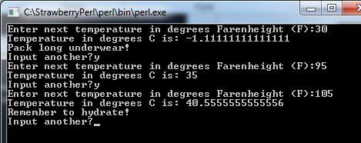
Project Time - PERL
Industry 1: Science
Language: Perl
Project: Temperature Converter (F to C)
Requirement: Get user input of temp in F, convert to C and give them feedback on what to wear based on the temp.
Bonus: Change the program to convert from C to F (or both) and ask for user’s name

Slide 38
Project Time - PERL
Download software: http://www.perl.org/
Install the Perl compiler on your computer or laptop. Recommend using “Strawberry Perl” for Windows.
Open a text editor (notepad, textedit, vi, or your favorite) and copy/paste the provided text into a file.
Save it as “Temp.pl” to your desktop.
Right-click the file and choose to “Execute Perl Program” or follow steps on next page.

Slide 39
Project Time - PERL
Open a command window (cmd.exe, or Unix shell) on your computer and navigate the default directory to the place where you stored “Temp.pl”
Use commands like a real programmer:
cd to change directory
dir to get a directory listing ( dir /ON will sort the directories in alphabetical order)
Hint: start with “cd C:\Users” then type dir to find the next level, etc. until you get to the desktop → TAB is a shortcut to scroll thru the directories
Run the program with the command “perl Temp.pl”

Slide 40
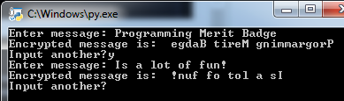
Project Time - Python
Industry 2: Business
Language: Python
Project: Simple encryption
Requirement: Make a program that will take user input and reverse all the characters, then display the output on screen.
Bonus: Convert each character to a 2-digit number instead. Consider how to handle special characters like spaces and punctuation. See if you can send a message to another member of the class.

Slide 41
Project Time - Python
Install the Python compiler and tools on your computer or laptop. This is available in a single download file from python.org. For Mac OS X and some Linux computers, Python is already installed.
Open a text editor (notepad, textedit, or your favorite) and copy/paste the provided program into a file. If you installed Python into a Windows computer, it included a program called IDLE, which can edit and run Python programs.
Save it as “Flip.py” to your desktop.
You can often double-click to open the program in Python, or follow steps on next page.

Slide 42
Project Time - Python
Open a command window (cmd.exe, or Unix shell) on your computer and navigate the default directory to the place where you stored “Flip.py”
Use commands like a real programmer:
cd to change directory
dir to get a directory listing ( dir /ON will sort the directories in alphabetical order)
Hint: start with “cd C:\Users” then type dir to find the next level, etc. until you get to the desktop → TAB is a shortcut to scroll thru the directories
Run the program with the command “python Flip.py”. If you are running IDLE, then just select the menu option Run -> Run Module.

Slide 43
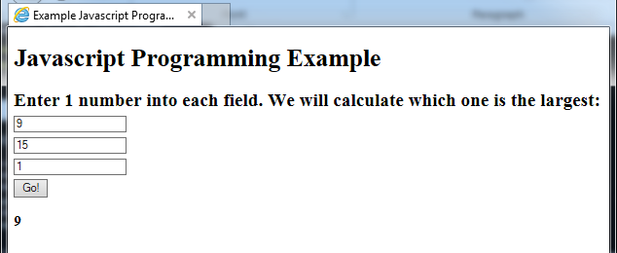
Project Time - Javascript
Industry 3: Internet / Social Media
Language: Javascript +
HTML wrapper
Project: Biggest number
Requirement: Get user input of 3 numbers. Compare the numbers and return the largest number.
Bonus: Change the program to return the smallest number instead.

Slide 44
Project Time - Javascript
Nothing to install.
Open a text editor (notepad, textedit, or your favorite) and copy/paste the provided text into a file. Save it as “ThreeNums.htm” to your desktop.
You can open this by double clicking (default browser) or but right-clicking to select the specific browser you want to use.

